Slide 1
Chapter 2: The Organization and Graphic Presentation of Data

Slide 2
Introduction
Examining a population.
Organizing and summarizing data.
Methods used by social scientists.
Notes:
Examining the size of the population: Demographers examine the size, composition, and distribution of human populations. Changes in the birth, death, and migration rates of a population affect its composition and social characteristics.
Organizing and summarizing the data: To make sense out of these data, a researcher must organize and summarize the data in some systematic fashion.
Methods used by social scientists:
Creation of frequency distributions.
The use of graphic presentation.

Slide 3
Frequency Distributions (1 of 2)
Most basic way to organize data.
Table that reports number of observations.
First step in statistical analysis of data.
Notes:
Satisfies Learning Objective 2.1: Construct and analyze frequency, percentage, and cumulative distribution.
The most basic way to organize data is to classify the observations into a frequency distribution.
A frequency distribution is a table that reports the number of observations that fall into each category of the variable we are analyzing.
First step in statistical analysis of data: Constructing a frequency distribution is usually the first step in the statistical analysis of data.

Slide 4
Frequency Distributions (2 of 2)
Table 2.1 Frequency Distribution for Categories of Region of Birth for
Foreign-Born Population, 2016
Region of Birth | Frequency (f )
South and East Asia | 11,731,584
Mexico | 11,568,060
Europe/Canada | 5,785,135
Caribbean | 4,300,022
Central America | 3,463,389
South America | 2,927,145
Middle East | 1,875,264
Sub-Saharan Africa | 1,769,778
All other | 261,277
Total | 43,681,654
Source: “2016, Foreign-Born Population in the United States Statistical Portrait”, Pew Research Center,
Washington, D.C (SEPTEMBER 14, 2018), https://www.pewhispanic.org/2018/09/14/2016-statisticalinformation-
on-foreign-born-in-united-states/.
Notes:
Satisfies Learning Objective 2.1: Construct and analyze frequency, percentage, and cumulative distribution.
Table 2.1 shows the frequency distribution of the world region of birth for the foreign-born population:
The frequency distribution is organized in a table, which has a number (2.1).
The descriptive title indicates the kind of data presented: “Categories of Region of Birth for Foreign-Born Population.”
The table consists of two columns.
The first column identifies the variable (world region of birth) and its categories.
The second column, with the heading “Frequency (f),” tells the number of cases in each category as well as the total number of cases.
The source of the table is clearly identified.

Slide 5
Proportions and Percentages (1 of 4)
Shortcomings of frequency distribution.
Standardizing raw frequencies.
Proportion.
Notes:
Satisfies Learning Objective 2.1: Construct and analyze frequency, percentage, and cumulative distribution.
Shortcomings of frequency distribution: Frequency distributions are helpful in presenting information in a compact form. However, when the number of cases is large, the frequencies may be difficult to grasp.
To standardize these raw frequencies: We can translate them into relative frequencies, that is, proportions or percentages.
A proportion is a relative frequency obtained by dividing the frequency in each category by the total number of cases.

Slide 6
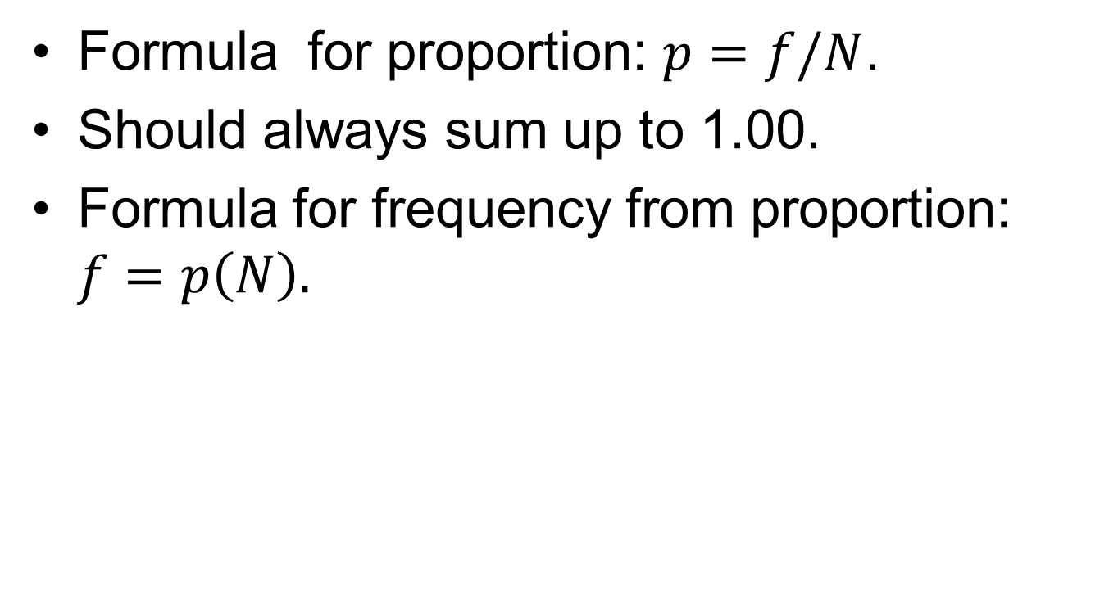
Proportions and Percentages (2 of 4)
Formula for proportion: $p=f/N$.
Should always sum up to 1.00.
Formula for frequency from proportion: $f=p\left(N\right).$
Notes:
Satisfies Learning Objective 2.1: Construct and analyze frequency, percentage, and cumulative distributions.
To find a proportion (p), divide the frequency (f) in each category by the total number of cases (N).
$$p=\frac{f}{N} ,$$
where f = frequency and N = total number of cases.
Proportions should always sum to 1.00 (allowing for some rounding errors).
To determine a frequency from a proportion, we simply multiply the proportion by the total N: $f=p\left(N\right).$

Slide 7
Proportions and Percentages (3 of 4)
Obtained frequency different from actual frequency.
To obtain correct frequency.
Notes:
Satisfies Learning Objective 2.1: Construct and analyze frequency, percentage, and cumulative distributions.
Obtained frequency differs somewhat from the actual frequency: This difference is due to rounding off of the proportion.
To obtain correct frequency: We use the actual proportion instead of the rounded proportion.

Slide 8
Proportions and Percentages (4 of 4)
Percentage: Relative frequency.
Frequency presented as percentages.
Calculation of percentage.
Formula.
Notes:
Satisfies Learning Objective 2.1: Construct and analyze frequency, percentage, and cumulative distributions.
A percentage is a relative frequency obtained by dividing the frequency in each category by the total number of cases and multiplying by 100.
In most statistical reports, frequencies are presented as percentages rather than proportions.
To calculate a percentage, multiply the proportion by 100:
Formula:
$Percentage \left(\%\right)=\frac{f}{N}\left(100\right)$or
$Percentage \left(\%\right)=p\left(100\right)$

Slide 9
Percentage Distributions
Table showing percentage of observations.
Should always show the base.
Notes:
Satisfies Learning Objective 2.2: Calculate proportions and percentages.
A percentage distribution is a table showing the percentage of observations falling into each category of the variable. Percentages are usually displayed as percentage distributions.
Percentage distributions (or proportions) should always show the base (N), on which they were computed.

Slide 10
The Constructions of Frequency Distributions (1 of 8)
Table 2.2 Frequency Distribution for Categories of Region of Birth for
Foreign-Born Population, 2016
Region of Birth | Frequency (f ) | Percentage (%)
South and East Asia | 11,731,584 | 27
Mexico | 11,568,060 | 27
Europe/Canada | 5,785,135 | 13
Caribbean | 4,300,022 | 10
Central America | 3,463,389 | 8
South America | 2,927,145 | 7
Middle East | 1,875,264 | 4
Sub-Saharan Africa | 1,769,778 | 4
All other | 261,277 | 1
Total | 43,681,654 | 100* (rounded)
Source: “2016, Foreign-Born Population in the United States Statistical Portrait”, Pew Research Center,
Washington, DC (SEPTEMBER 14, 2018), https://www.pewhispanic.org/2018/09/14/2016-statisticalinformation-
on-foreign-born-in-united-states/.
Notes:
Satisfies Learning Objective 2.2: Calculate proportions and percentages.
Table 2.2: Frequency Distribution of Categories of Places of Origin (Table 2.1) along with the Corresponding Percentage Distribution.

Slide 11
The Constructions of Frequency Distributions (2 of 8)
How to construct frequency distribution.
Frequency distribution for nominal and ordinal variables.
Notes:
Satisfies Learning Objective 2.1: Construct and analyze frequency, percentage, and cumulative distributions.
To construct frequency distributions:
Most often, we can use statistical software to accomplish this.
It is important to go through the process to understand how frequency distributions are actually constructed.
Frequency distribution for nominal and ordinal variables:
For nominal and ordinal variables, constructing a frequency distribution is quite simple.
To do so, count and report the number of cases that fall into each category of the variable along with the total number of cases (N).

Slide 12
The Constructions of Frequency Distributions (3 of 8)
Frequency Distributions for Nominal Variables
Adding percentage distributions.
Notes:
Satisfies Learning Objective 2.1: Construct and analyze frequency, percentage, and cumulative distributions.
Adding percentage distributions:
The percentage column is the percentage distribution for this variable.
To convert the frequency column to percentages, simply divide each frequency by the total number of cases and multiply by 100.
Percentage distributions are routinely added to almost any frequency table and are especially important if comparisons with other groups are to be considered.
Immediately, we can see that it is easier to read the information.
Based on this frequency distribution, we can also conclude that the majority of sample respondents are female.

Slide 13
The Constructions of Frequency Distributions (4 of 8)
Frequency Distributions for Nominal Variables
Table 2.4 Frequency Distribution of the Variable Gender: GSS Subsample
Gender | Tallies | Frequency (f ) | Percentage (%)
Male |  | 15 | 37.5
Female |  | 25 | 62.5
Total (N) |  | 40 | 100.0
Notes:
Satisfies Learning Objective 2.3: Compare and contrast frequency and percentage distributions for nominal, ordinal, and interval-ratio variables.
Table 2.4: A Frequency Distribution of the Nominal Variable Gender.
First, we tally the number of males, then the number of females (the column of tallies has been included in table for the purpose of illustration).
The tally results are then used to construct the frequency distribution.
The table has a title describing its content.
Its categories (male and female) and their associated frequencies are clearly listed.
In addition, the total number of cases (N) is also reported.

Slide 14
The Constructions of Frequency Distributions (5 of 8)
Frequency Distributions for Ordinal Variables
Construction of frequency distribution.
Difference between nominal and ordinal variables.
Notes:
Satisfies Learning Objective 2.3: Compare and contrast frequency and percentage distributions for nominal, ordinal, and interval-ratio variables.
To construct a frequency distribution for ordinal-level variables: Follow the same procedures outlined for nominal-level variables.
Difference between frequency distributions for nominal and ordinal variables:
The major difference is the order in which the categories are listed.
The categories for nominal-level variables do not have to be listed in any particular order. For example, we could list females first and males second without changing the nature of the distribution.
Because the categories or values of ordinal variables are rank-ordered, however, they must be listed in a way that reflects their rank from the lowest to the highest or from the highest to the lowest.
Thus, the data on degree in table are presented in declining order from “less than high school” (the lowest educational category) to “graduate” (the highest educational category).

Slide 15
The Constructions of Frequency Distributions (6 of 8)
Frequency Distributions for Ordinal Variables
Table 2.5 Frequency Distribution of the Variable Degree: GSS Subsample
Degree | Tallies | Frequency (f ) | Percentage (%)
Less than high school |  | 4 | 10.0
High school |  | 24 | 60.0
Bachelor |  | 6 | 15.0
Graduate |  | 6 | 15.0
Total (N) |  | 40 | 100.0
Notes:
Satisfies Learning Objective 2.3: Compare and contrast frequency and percentage distributions for nominal, ordinal, and interval-ratio variables.
Table 2.5: Frequency Distribution of the Variable Degree, GSS Subsample.
It presents the frequency distribution for the variable degree: The table shows that 60.0%, a majority, indicated that their highest degree was a high school degree.

Slide 16
The Constructions of Frequency Distributions (7 of 8)
Frequency Distributions for Interval-Ratio Variables
Wide range of values.
Large number of scores.
Grouped into class intervals.
Percentage distribution displays relative frequency.
Notes:
Satisfies Learning Objective 2.3: Compare and contrast frequency and percentage distributions for nominal, ordinal, and interval-ratio variables.
Wide range of values: Very often interval-ratio variables have a wide range of values, which makes simple frequency distributions very difficult to read.
Large number of scores: For a more concise picture, the large number of different scores could be reduced into a smaller number of groups, each containing a range of scores.
Grouped into class intervals: Having grouped the scores, we can clearly see that the biggest single age group is between 40 and 49 years (12 out of 40, or 30% of sample).
The percentage distribution displays the relative frequency: Of each interval and emphasizes this pattern as well.

Slide 17
The Constructions of Frequency Distributions (8 of 8)
Frequency Distributions for Interval-Ratio Variables
Table 2.8 Grouped Frequency Distribution of the Variable Age: GSS Subsample
Age Category | Frequency (f ) | Percentage (%)
20–29 | 7 | 17.5
30–39 | 7 | 17.5
40–49 | 12 | 30.0
50–59 | 3 | 7.5
60–69 | 3 | 7.5
70–79 | 6 | 15.0
80–89 | 2 | 5.0
Total (N) | 40 | 100.0
Notes:
Satisfies Learning Objective 2.3: Compare and contrast frequency and percentage distributions for nominal, ordinal, and interval-ratio variables.
Table 2.8: Grouped Frequency Distribution of the Variable Age, GSS Subsample.

Slide 18
Cumulative Distributions (1 of 3)
Locating relative position of a score.
Appropriate for ordinal levels or higher.
Adding frequencies of categories below.
Notes:
Satisfies Learning Objective 2.1: Construct and analyze frequency, percentage, and cumulative distributions.
Locating relative position of a score: Frequency distributions can be presented in a cumulative fashion to answer such questions.
A cumulative frequency distribution shows the frequencies at or below each category of the variable.
Cumulative frequencies are appropriate only for variables that are measured at an ordinal level or higher.
They are obtained by adding to the frequency in each category the frequencies of all the categories below it.

Slide 19
Cumulative Distributions (2 of 3)
Table 2.9 Grouped Frequency Distribution and Cumulative Frequency for
the Variable Age: GSS Subsample
Age Category | Frequency (f ) | Cumulative Frequency (Cf )
20–29 | 7 | 7
30–39 | 7 | 14
40–49 | 12 | 26
50–59 | 3 | 29
60–69 | 3 | 32
70–79 | 6 | 38
80–89 | 2 | 40
Total (N) | 40
Notes:
Satisfies Learning Objective 2.1: Construct and analyze frequency, percentage, and cumulative distributions.
Table 2.9: Cumulative Frequencies Based on the Frequency Distribution from Table 2.8.
It shows the cumulative frequencies based on the frequency distribution:
The cumulative frequency column, denoted by Cf, shows the number of persons at or below each interval.
For example, you can see that 14 of the 40 respondents were 39 years old or younger, and 29 respondents were 59 years old or younger.
To construct a cumulative frequency distribution, start with the frequency in the lowest class interval (or with the lowest score, if the data are ungrouped), and add to it the frequencies in the next highest class interval.
Continue adding the frequencies until you reach the last class interval. The cumulative frequency in the last class interval will be equal to the total number of cases (N).
In Table 2.9, the frequency associated with the first class interval (20–29) is 7.
The cumulative frequency associated with this interval is also 7, since there are no cases below this class interval.
The frequency for the second class interval is 7.
The cumulative frequency for this interval is $7+7=14$.
To obtain the cumulative frequency of 26 for the third interval, we add its frequency (12) to the cumulative frequency associated with the second class interval (14).
Continue this process until your each the last class interval. Therefore, the cumulative frequency for the last interval is equal to 40, the total number of cases (N).

Slide 20
Cumulative Distributions (3 of 3)
Cumulative percentage distribution.
Wider applications.
Useful when comparing group differences.
Notes:
Satisfies Learning Objective 2.1: Construct and analyze frequency, percentage, and cumulative distributions.
A cumulative percentage distribution shows the percentage at or below each category (class interval or score) of the variable.
This has wider applications than the cumulative frequency distribution.
It is constructed using the same procedure as for a cumulative frequency distributions except the percentages—rather than the frequencies—for each category are added to the total percentages for all the previous categories.
These are useful when comparing differences between groups.

Slide 21
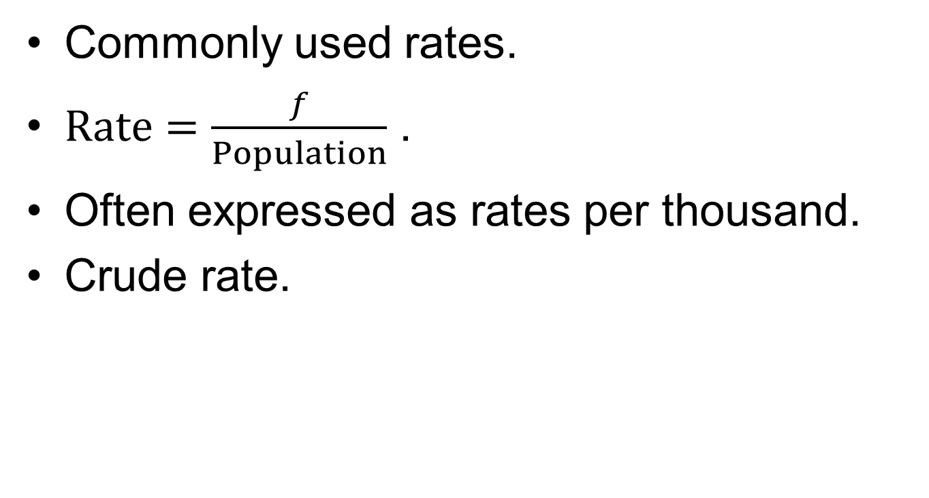
Rates
Commonly used rates.
$Rate=\frac{f}{Population}$ .
Often expressed as rates per thousand.
Crude rate.
Notes:
Satisfies Learning Objective 2.1: Construct and analyze frequency, percentage, and cumulative distributions.
Commonly used rates: Terms such as birthrate, unemployment rate, and marriage rate are often used by social scientists and demographers and then quoted in the popular media to describe population trends.
A rate is obtained by dividing the number of actual occurrences in a given time period by the number of possible occurrences.
Rates are often expressed as rates per thousand or hundred thousand to eliminate decimal points and make the number easier to interpret.
Crude rate is based on the total population.

Slide 22
Graphic Presentation of Data
Statistical graphs.
Visual communication of information.
More accessible than tabular data.
Notes:
Satisfies Learning Objective 2.4: Construct and interpret a pie chart, bar graph, histogram, the statistical map, line graph, and time-series chart.
Statistical graphs summarize hundreds or thousands of numbers.
Graphs communicate information visually rather than in words or numbers and are often utilized in news stories, research reports, and government documents.
More accessibility than tabular data: Information presented graphically may seem more accessible than the same information when presented in frequency distributions or in other tabular forms.

Slide 23
The Pie Chart (1 of 2)
Displayed as segments of circle.
All pieces add up to 100%.
Easy interpretation of information.
Notes:
Satisfies Learning Objective 2.4: Construct and interpret a pie chart, bar graph, histogram, the statistical map, line graph, and time-series chart.
A pie chart shows the differences in frequencies or percentages among the categories of a nominal or an ordinal variable.
Displayed as segments of circle: The categories are displayed as segments of a circle whose pieces add up to 100% of the total frequencies.

Slide 24
The Pie Chart (2 of 2)
Table 2.13 Five-Year Estimates of the U.S. Population 65 Years and Over by
Race, 2013–2017
Race | Percentage (%)
White alone | 83.5
Black alone | 8.9
American Indian or Alaska Native | 0.5
Asian alone | 4.2
Native Hawaiian or Pacific Islander alone | 0.1
Some other race alone | 1.7
Two or more races combined | 1.0
Total | 99.9
Source: U.S. Census Bureau, American Fact Finder, Table S0103, 2017.
Notes:
Satisfies Learning Objective 2.4: Construct and interpret a pie chart, bar graph, histogram, the statistical map, line graph, and time-series chart.
Table 2.13: Five-Year Estimates of the US Population 65 Years and Over by Race, 2013–2017.

Slide 25
The Bar Graph
Alternative way to present data.
Categories displayed as rectangles.
Construction of bar graph.
Often used to compare variables.
Notes:
Satisfies Learning Objective 2.4: Construct and interpret a pie chart, bar graph, histogram, the statistical map, line graph, and time-series chart.
The bar graph provides an alternative way to graphically present nominal or ordinal data. It shows the differences in frequencies or percentages among categories of a nominal or an ordinal variable.
The categories are displayed as rectangles of equal width with their height proportional to the frequency or percentage of the category.
Construction of bar graph:
First label the categories of the variables along the horizontal axis.
For these categories, construct rectangles of equal width, with the height of each proportional to the frequency or percentage of the category.
Note that a space separates each of the categories to make clear that they are nominal categories.
Bar graphs are often used to compare variables:
Suppose we want to show how the patterns in marital status differ between men and women.
The longevity of women is a major factor in the gender differences in marital and living arrangements.
Elderly widowed men are more likely to remarry than elderly widowed women.

Slide 26
The Histogram
Shows differences in frequencies or percentages.
Difference between histogram and bar graph.
Construction of histogram.
Notes:
Satisfies Learning Objective 2.4: Construct and interpret a pie chart, bar graph, histogram, the statistical map, line graph, and time-series chart.
The histogram is used to show the differences in frequencies or percentages among categories of an interval-ratio or ordinal variable.
The categories are displayed as contiguous bars.
Width is proportional to the width of the category.
Height proportional to the frequency or percentage of that category.
Difference between a histogram and a bar graph:
A histogram looks very similar to a bar graph except that the bars are contiguous to each other (touching) and may not be of equal width.
In a bar graph, the spaces between the bars visually indicate that the categories are separate. In a histogram, the touching bars indicate that the categories or intervals are ordered from low to high in a meaningful way.
Construction of histogram:
Arrange the age intervals along the horizontal axis and the frequencies (or percentages) along the vertical axis.
For each age category, construct a bar with the height corresponding to the frequency of the elderly in the population in that age category.
The width of each bar corresponds to the number of years that the age interval represents.
The bar for each category is touching the bar associated with the category above and below.
The area that each bar occupies tells us the number of individuals that falls into a given age interval.
Note that the figure title includes the notation “numbers in thousands.”
You should multiply each reported frequency by 1000.

Slide 27
The Statistical Map
Represents geographical data pattern.
Wide range of level.
Notes:
Satisfies Learning Objective 2.4: Construct and interpret a pie chart, bar graph, histogram, the statistical map, line graph, and time-series chart.
A statistical map presents geographic data patterns or variations, such as population distribution, voting patterns, crime rates, or labor force composition.
It presents a statistical map, by state, of the percentage of the population.
Wide range of level: Maps may also display geographical patterns on the level of cities, counties, city blocks, census tracts, and other units. Your choice of whether to display variations on the state level or for smaller units will depend on the research question you wish to explore.

Slide 28
The Line Graph
Displays interval ratio distributions.
Shows differences in frequencies of categories.
Advantage over histogram.
Points placed above midpoint.
Notes:
Satisfies Learning Objective 2.4: Construct and interpret a pie chart, bar graph, histogram, the statistical map, line graph, and time-series chart.
The line graph is another way to display interval-ratio distributions.
It shows the differences in frequencies or percentages among categories of an interval-ratio variable.
Compared with histograms: Line graphs are better suited for comparing how a variable is distributed across two or more groups or across two or more time periods.
Points placed above midpoint: Points representing the frequencies of each category are placed above the midpoint of the category and are joined by a straight line.

Slide 29
The Time-Series Chart
Changes in variable at different points of time.
Involves two variables.
Construction of time series chart.
Notes:
Satisfies Learning Objective 2.4: Construct and interpret a pie chart, bar graph, histogram, the statistical map, line graph, and time-series chart.
A time-series chart displays changes in a variable at different points in time.
It involves two variables:
Time, which is labeled across the horizontal axis.
Another variable of interest whose values (frequencies, percentages, or rates) are labeled along the vertical axis.
Construction of time series chart: To construct a time-series chart, use a series of dots to mark the value of the variable at each time interval and then join the dots by a series of straight lines.

