Slide 1
Chapter 7: Estimation

Slide 2
Introduction (1 of 2)
Estimating population means and proportions.
Sampling distribution.
Estimation.
Notes:
Satisfies Learning Objective 7.1: Explain the concept of estimation, point estimates, confidence level, and confidence interval.
Procedure of estimating population means and proportions: Based on the principles of sampling and statistical inference.
Sampling distribution: Allows us to estimate population means and proportions: From sample outcomes and to assess the accuracy of these estimates.
Estimation: A process whereby we select a random sample from a population and use a sample statistic to estimate a population parameter.

Slide 3
Introduction (2 of 2)
Use of sample proportions, sample means, and sample variances as estimates.
Sampling theory and statistical inference.
Notes:
Satisfies Learning Objective 7.1: Explain the concept of estimation, point estimates, confidence level, and confidence interval.
Use of sample proportions, sample means, and sample variances as estimates: We can use sample proportions as estimates of population proportions, sample means as estimates of population means, or sample variances as estimates of population variances.
Major objective of sampling theory and statistical inference: To provide estimates of unknown population parameters from sample statistics.

Slide 4
Point and Interval Estimation (1 of 2)
Types for estimates of population characteristics.
Interval estimates more accurate than point estimates.
Notes:
Satisfies Learning Objective 7.1: Explain the concept of estimation, point estimates, confidence level, and confidence interval.
Estimates of population characteristics divided into two types:
Point estimates: Sample statistics used to estimate the exact value of a population parameter.
Examples:
When the Pew Research Organization reports that 62% of Americans believe immigrants strengthen the country, they are using a point estimate.
Similarly, if we reported the average level of education of the population of adult Americans to be exactly 13.71 years, we would be using a point estimate.
Interval estimates: Ranges of values within which the population parameter may fall.
Interval estimates more accurate than point estimates: The problem with point estimates is that sample statistics vary, usually resulting in some sort of sampling error. Thus, we never really know how accurate they are. As a result, we rarely rely on them as estimators of population parameters such as average income or percentage of the population who are in favor of gay and lesbian relations.

Slide 5
Point and Interval Estimation (2 of 2)
Margin of error.
Confidence interval (CI) defined in terms of confidence levels.
Notes:
Satisfies Learning Objective 7.1: Explain the concept of estimation, point estimates, confidence level, and confidence interval.
Confidence interval (CI): The range of values within which the population parameter may fall that we identify in interval estimation.
Margin of error: The radius of a confidence interval.
Confidence level: While using confidence intervals to estimate population parameters, we can evaluate their accuracy by assessing the likelihood that any given interval will contain the mean. This likelihood, expressed as a percentage or a probability, is called a confidence level. It can be constructed for different parameters based on corresponding sample statistics.

Slide 6
Confidence Intervals for Means (1 of 8)
Assessing the needs of commuter students.
Calculation of sample average.
Calculation of sampling distribution of the mean: $σ_{\overline{Y}}=\frac{σ}{\sqrt{N}}$.
Assumptions.
Notes:
Satisfies Learning Objective 7.2: Calculate and interpret confidence intervals for means.
Assessing the needs of commuter students:
Survey a random sample of 500 students to estimate the average commuting time of all 15,000 commuters on our campus—the population parameter.
To obtain this estimate, we calculate the average commuting time for the sample. Suppose the sample average is Y = 7.5 h/week.
Because it is based on a sample, this estimate is subject to sampling error. It is unlikely that our sample mean, Y= 7.5 h/week deviates much from the true population mean. (Central limit theorem: For a large enough sample size, most sample means will tend to be close to the true population mean.)
Sampling distribution of the mean = $σ_{\overline{Y}}=\frac{σ}{\sqrt{N}} (\text{population} \text{mean} \text{μ} \text{and} \text{a} \text{standard} \text{error} σ_{\overline{Y}}\text{).}$
Allows us to use the normal distribution to determine the probability that a sample mean will fall within a certain distance—measured in standard deviation (standard error) units or Z scores—of μ or $μ_{\overline{Y}}$.
Assumptions:
A total of 68% of all random sample means will fall within ±1 standard error of the true population mean.
A total of 95% of all random sample means will fall within ±1.96 standard errors of the true population mean.
A total of 99% of all random sample means will fall within ±2.58 standard errors of the population mean.

Slide 7
Confidence Intervals for Means (2 of 8)
Determining the Confidence Interval
Calculate standard error of the mean.
Decide on the level of confidence, and find the corresponding Z value.
Calculate the confidence interval.
Interpret the results.
Notes:
Satisfies Learning Objective 7.2: Calculate and interpret confidence intervals for means.

Slide 8
Confidence Intervals for Means (3 of 8)
Reducing Risk
Increasing the level of confidence.
Trade-off between greater confidence and precision of estimate.
Notes:
Satisfies Learning Objective 7.3: Describe the concept of risk and how to reduce it.
Increasing the level of confidence: To reduce risk of being incorrect.
Trade-off between achieving greater confidence in an estimate and the precision of that estimate: As the width of the confidence interval increases.

Slide 9
Confidence Intervals for Means (4 of 8)
Reducing Risk
Table 7.1 Confidence Levels and Corresponding Z Values
Confidence Level | Z Value
90% | 1.65
95% | 1.96
99% | 2.58
Notes:
Satisfies Learning Objective 7.3: Describe the concept of risk and how to reduce it.
Table 7.1: Confidence Levels and Corresponding Z Values.
It lists three commonly used confidence levels along with their corresponding Z values.

Slide 10
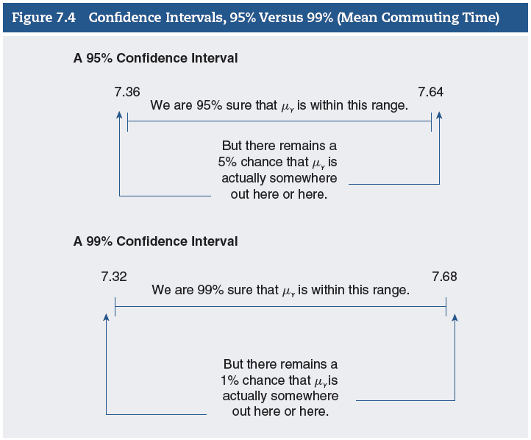
Confidence Intervals for Means (5 of 8)
Reducing Risk
Notes:
Satisfies Learning Objective 7.3: Describe the concept of risk and how to reduce it.
Figure 7.4 illustrates the relationship between the confidence level and the precision of the confidence interval.

Slide 11
Confidence Intervals for Means (6 of 8)
Estimating Sigma
Necessary to calculate confidence interval.
Standard error: $σ_{\overline{Y}}=\frac{σ}{\sqrt{N}}$.
Standard error using sample deviation: $s_{\overline{Y}}=\frac{s}{\sqrt{N}}$.
Notes:
Satisfies Learning Objective 7.2: Calculate and interpret confidence intervals for means.
Standard error: It is a function of the population standard deviation and the sample size.
Standard error of the sampling distribution is necessary: To calculate confidence interval.

Slide 12
Confidence Intervals for Means (7 of 8)
Sample Size and Confidence Intervals
Table 7.2 Ninety-Five Percent Confidence Interval and Width for Mean
Number of Hours per Day Watching Television for Three Different
Sample Sizes
Sample Size (N) | Confidence Interval | Interval Width | s | s_{Y}
150 | 2.48–3.42 | 0.94 | 2.94 | 0.24
778 | 2.73–3.17 | 0.44 | 2.94 | 0.11
1,556 | 2.81–3.09 | 0.28 | 2.94 | 0.07
Notes:
Satisfies Learning Objective 7.2: Calculate and interpret confidence intervals for means.
Table 7.2: Ninety-Five Percent Confidence Interval and Width for Mean Number of Hours Per Day Watching Television for Three Different Sample Sizes
In Table 7.2, we summarize the 95% confidence intervals for the mean number of hours watching television for these three sample sizes: $N = 150$, $N = 778$, and $N = 1,556$.
Although precision of estimates increases steadily with sample size, the gains would appear to be rather modest after N reaches 1556. Researchers have to consider at what point the increase in precision is too small to justify the additional cost associated with a larger sample.

Slide 13
Confidence Intervals for Means (8 of 8)
Sample Size and Confidence Intervals
Inverse relationship between sample size and width of confidence interval.
Increase in sample size, increased precision of confidence interval.
Notes:
Satisfies Learning Objective 7.2: Calculate and interpret confidence intervals for means.
Increase in sample size linked with increased precision of confidence interval: Researchers can increase precision of estimate and CI by increasing sample size.

Slide 14
Statistics in Practice: Hispanic Migration and Earnings (1 of 2)
Study of discrepancy in earnings between Hispanic population groups.
Notes:
Satisfies Learning Objective 7.2: Calculate and interpret confidence intervals for means.
Marta Tienda and Franklin Wilson’s study of discrepancy in earnings between Hispanic population groups:
The gap in earnings has been attributed mainly to differences in migration status and in level of education.
Marta Tienda and Franklin Wilson argued that Mexicans, Puerto Ricans, and Cubans varied markedly in socioeconomic characteristics because of differences in the timing and circumstances of their immigration to the United States.
Tienda and Wilson also noted persistent differences in educational levels among Mexicans and Puerto Ricans compared with Cubans, which were likely to be reflected in disparities in earnings among the three groups.
We would anticipate that the earnings of Cubans would be higher than the earnings of Mexicans and Puerto Ricans.

Slide 15
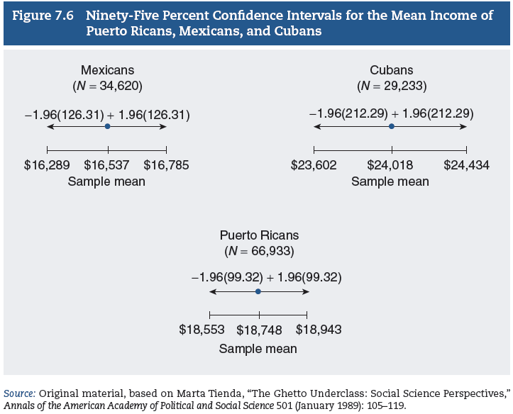
Statistics in Practice: Hispanic Migration and Earnings (2 of 2)
What Affects Confidence Interval Width?
Notes:
Satisfies Learning Objective 7.2: Calculate and interpret confidence intervals for means.
Figure 7.6: The confidence intervals for mean annual income of Cuban, Puerto Rican, and Mexican immigrants are illustrated in this figure. We can say with 95% confidence that the true income mean for each Hispanic group lies somewhere within the corresponding confidence interval. Note that the confidence intervals do not overlap, thus revealing great disparities in earnings among the three groups. Highest interval estimates are for Cubans, followed by Mexicans and then Puerto Ricans.

Slide 16
Confidence Intervals for Proportions (1 of 4)
Sample proportions or percentages usually reported with a margin error.
Margin of error uses.
Conceptual foundations.
Notes:
Satisfies Learning Objective 7.4: Calculate and interpret confidence intervals for proportions.
Sample proportions or percentages are usually reported along with a margin error: Plus or minus a particular value.
Margin of error uses: It is the confidence interval and is used to estimate population proportions or percentages.
Conceptual foundations: The same conceptual foundations of sampling and statistical inference that are central to the estimation of population means (the selection of random samples and the special properties of the sampling distribution) are also central to the estimation of population proportions.

Slide 17
Confidence Intervals for Proportions (2 of 4)
Sampling distribution of proportions.
Features of sufficient sample size.
Notes:
Satisfies Learning Objective 7.4: Calculate and interpret confidence intervals for proportions.
Sampling distribution of proportions: Underlies the estimation of population proportions from sample proportions.
Sufficient sample size:
Sampling distribution of proportions is approximately normal.
Mean μp equal to the population proportion π.
Standard error of proportions: $σ_{p}=\sqrt{\frac{\left(π\right)\left(1−π\right)}{N}}.$Here, $σ_{p}$ is the standard error of proportions, π is the population proportion, and N is the population size.
Estimated standard error: $s_{p}=\sqrt{\frac{\left(p\right)\left(1−p\right)}{N}}.$Here, $s_{p}$ is the estimated standard error of proportions, $p$ is the sample proportion, and N is the sample size.

Slide 18
Confidence Intervals for Proportions (3 of 4)
Determining the Confidence Interval
$CI=p±Z(s_{p)}.$
Area between the mean and selected ±Z = Confidence level.
Notes:
Satisfies Learning Objective 7.4: Calculate and interpret confidence intervals for proportions.
General formula for constructing CI for proportions for any level of confidence: $CI=p±Z(s_{p)}.$Here, CI is the confidence interval, p is the observed sample proportion, Z is the Z corresponding to the confidence level, and $s_{p}$ is the estimated standard error of proportions. To obtain a confidence interval at a certain level, we take the sample proportion and add to or subtract from it the product of a Z value and the standard error.
We want the area between the mean and the selected ±Z to be equal to the confidence level: The Z value we choose depends on the desired confidence level

Slide 19
Confidence Intervals for Proportions (4 of 4)
Determining the Confidence Interval
Steps to determine the confidence interval for a proportion:
Calculate the estimated standard error of the proportion.
Decide the desired level of confidence, and find the corresponding Z value.
Calculate the confidence interval.
Interpret the results.
Notes:
Satisfies Learning Objective 7.4: Calculate and interpret confidence intervals for proportions.
Steps to determine the confidence interval for a proportion: We follow the same steps that were used to find confidence intervals for means.
Calculate the estimated standard error of the proportion.
Decide the desired level of confidence, and find the corresponding Z value.
Calculate the confidence interval.
Interpret the results.

Slide 20
Reading the Research Literature: Women Victims of Intimate Violence (1 of 3)
Study of women victims of intimate partner violence in New Zealand.
Notes:
Janet Fanslow and Elizabeth Robinson studied help-seeking behavior and motivation among women victims of intimate partner violence in New Zealand:
Relied on data from the New Zealand Violence against Women Study to document the reasons why victims sought help or left their partner due to domestic violence.
Fanslow and Robinson identified the categories with the highest percentages for each sample: For seeking help (could not endure more, encouraged by friends or family, children suffering and badly injured) and for leaving (could not endure more, he threatened to kill her, children suffering and badly injured).
Concern for children suffering was also identified as an important reason for female victims to seek help and/or to leave their abuser.
When estimates are reported for subgroups, the confidence intervals are likely to vary. Even when a confidence interval is reported only for the overall sample, we can easily compute separate confidence intervals for each of the subgroups if the confidence level and the size of each of the subgroups are included.

Slide 21
Reading the Research Literature: Women Victims of Intimate Violence (2 of 3)
Table 7.3 Percentage of Women With Lifetime Experience of Physical and/or Sexual Intimate Partner Violence Who Reported Reasons for Asking for Help With and for Leaving Violent Relationships
 | Reasons That Made You Go for Help (n = 486), (95% CI) | Reasons for Leaving the Last Time (n = 508), (95% CI)
Could not endure more | 48.5 (43.6–53.3) | 64.2 (59.8–68.6)
Encouraged by friends/family | 17.7 (14.0–21.5) | 6.7 (4.4–9.0)
Badly injured | 15.4 (12.0–18.7) | 7.1 (4.2–9.9)
He threated to kill her | 11.3 (8.1–14.5) | 10.2 (7.0–13.3)
Afraid he would kill her | 11.4 (8.3–14.6) | 5.9 (3.8–7.9)
Children suffering | 17.2 (13.5–20.9) | 8.6 (5.9–11.3)
He threatened or hit children | 7.9 (5.2–10.5) | 5.0 (3.0–7.0)
She was afraid she would kill him | 2.1 (0.8–3.5) | 1.2 (0.2–2.2)
She was thrown out of the home | 2.0 (0.6–3.3) | 2.2 (0.7–3.7)
For her mental health/save sanity | 8.2 (5.5–10.9) | —
To get information/legal help | 8.1 (5.5–10.6) | —
(continued)
Notes:
Table 7.3: Percentage of Women with Lifetime Experience of Physical and/or Sexual Intimate Partner Violence Who Reported Reasons for Asking for Help with and for Leaving Violent Relationships.

Slide 22
Reading the Research Literature: Women Victims of Intimate Violence (cont.) (3 of 3)
(Continued)
Encouraged by organization | — | 1.7 (0.1–3.3)
No particular incident | — | 5.3 (3.3–7.4)
He was unfaithful | — | 3.8(2.1–5.5)
She was pregnant | — | 1.4 (0.4–2.3)
To have time out/break from relationships | — | 1.4 (0.3–2.4)
Other | 22.4 (18.5–26.2) | 8.3 (5.6–10.9)
Source: Adapted from Janet Fanslow and Elizabeth Robinson, “Help Seeking Behaviors and Reasons for Help Seeking Reported by a
Representative Sample of Women Victims of Intimate Partner Violence in New Zealand,” Journal of Interpersonal Violence 25, no. 5 (2010):
929–951.
Note: Percentages sum to greater than 100% because individuals could provide multiple responses.
Notes:
Table 7.3: Percentage of Women with Lifetime Experience of Physical and/or Sexual Intimate Partner Violence Who Reported Reasons for Asking for Help with and for Leaving Violent Relationships.

